Slide 1
Easy Changing Tower
BY: David Brantley

Slide 2
What is this product
What is this product you may ask. This, is the product that will change
will reduce time spent on changing cases on a PC from one to another.
this will benefit gamer, computer designers, computer builders, et c.
The sizes range from mini to full tower.

Slide 3
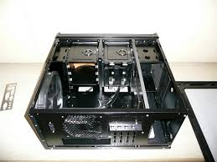
How does it work?
This product is very simple, inside of each box you will get this →
You will also get the outer layer to the case.
all you have to do is build the computer into the shell, and put it in the case.
Once in the case, all you have to do is screw in the shell, and you are ready to go. If you want to change the case, just unscrew it and slide it out and slide it in and screw it back into another case.

Slide 4
Any extra features?
Yes, the frame for the tower can be tacked and put into a bigger case.
The black boxes are the frames, the designs on them
are the case. The frames will have an assortment of cases
that can fit 1,2,3,4, or more cases in one but, you really only
need one. Unless, you are running 3 power supply boxes,
3 mother board, multiple xeons, et c.
Thats like 3 computers in one...

Slide 5
How could this be special?
In the world there are millions of PC gamers that like to change their style, and companies who want to upgrade the size and power of their work computers.

